Slide 1
Coronavirus (COVID-19)
Global Pandemic hotspot tracker

Slide 2
Elevator Pitch/ Concept
Create a simple app/site to visually display COVID-19 case numbers around the world
Motivation – it is interesting and topical
User – I am someone who has a general interest in knowing which countries have the highest rates of infection today/ I am considering travelling to another country, or in my own country and wish to know up-to-date global statistics.
Interface a world map API with the statistics API to display which countries have the highest case loads
App to be used for general information/travel information by consumers.
App to include some guidance on where to seek help/ how to get Emergency help in each country plus some simple guides on hygiene procedures for COVID-19 and also symptoms.

Slide 3
Process
Technology and Resources Used
GitHub
Trello Board
Breakdown of Tasks
Lihour – HTML Body, Trello Board
Yvette – Resources and Hygiene Pages
Challenges / Success
Github Branch merging/ approval
Visual Studio Code
RapidAPI
Materialize
Lucas - Github Project Hosting, Javascript, APIs
Louise – API and Javascript

Slide 4
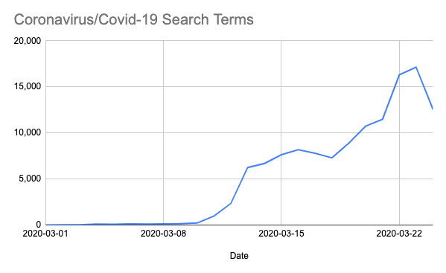
COVID-19 desire for data/apps
High Interest in COVID-19 Data From Software Developers:
https://rapidapi.com/blog/developers-respond-to-covid-19/
Developers around the world have expressed increasing interest in coronavirus/COVID-19 APIs.
The trend line for coronavirus/COVID-19 APIs closely resembles the trend line for new subscriptions to these APIs on RapidAPI.

Slide 5
Demo
… Directions for future development

Slide 6
Demo
Github Project
Github Webpage
https://github.com/ldipaola/bootcamp-project-1
Not yet online

Slide 7
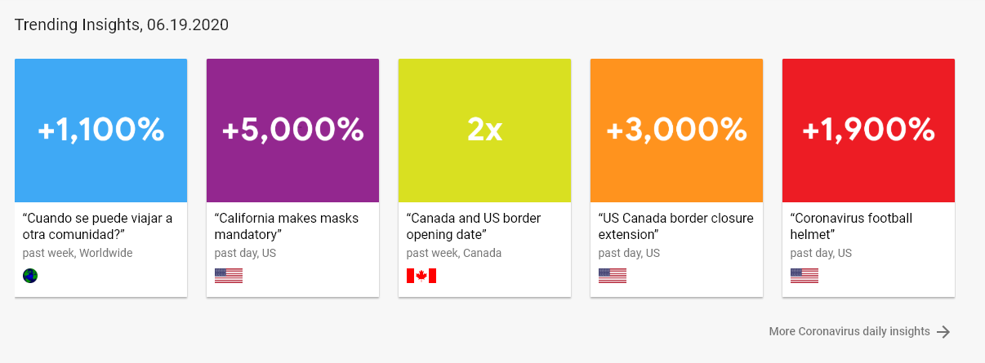
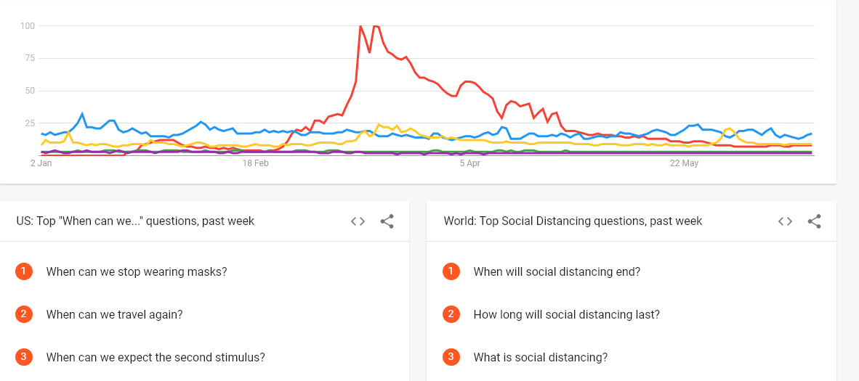
Directions for Future Development
Coronavirus remains topical
Data continues to be sought after for news, interest and travel purposes
As restrictions ease – people use a variety of resources to inform travel
Google Trends

